Slide 1

MAJOR CRIME INDICATORS (mci) - TORONTO
Project 1 – Analysis by category in Toronto from 2014 to 2018
Rakesh KUMAR
Iraldo Gomez
Daniel barrantes

Slide 2
Project Description/Outline:
Using publicly available data thru APIs and downloads our team will analyze the MCI by categories between 2014 and 2018 to find:
Correlation between the offence type and the day of week/time of day when the offence took place
Correlation between the offense type and the premise type (i.e. apartment, house) where the offence took place.
Correlation between the offense type and the median household income of the neighborhood where the offence took place.

Slide 3

Datasets to be used
Toronto Police Service API Data. Used for initial data exploration and sampling.
https://services.arcgis.com/S9th0jAJ7bqgIRjw/arcgis/rest/services/MCI_2014_to_2018/FeatureServer/0/query?where=1%3D1&outFields=*&outSR=4326&f=geojson
Toronto Police Service, Public Safety Data Portal. Used for extracting the full data set (167524 criminal ofences) in CSV format. This file became the core dataset of our project.
http://data.torontopolice.on.ca/datasets/mci-2014-to-2018
Represent Civic Information API, boundaries end-point. Used for finding the Toronto Ward where each ofence was commited.
https://represent.opennorth.ca/boundaries/?contains=45.524,-73.596
City of Toronto Open Data Catalog. Used for extracting the 2016 Ward profiles and their median household income.
https://www.toronto.ca/city-government/data-research-maps/open-data/open-data-catalogue/#0dcc4b06-b0e8-3db3-80d0-a10aed2a0312

Slide 4

Data Cleanup & Exploration
During the initial data exploration we discovered that:
The Toronto Police Service API would only provide a limited number of rows (2K). We then decided to used the downloaded CSV file as our core source of data (167K)
The granular level for the MCI data is neighborhood, which did not match the granular level of the median household income data which is Ward. We decided to used an API call in order to get the ward information by using the LAT and LONG where the offence took place.
The Ward information returned by the API contains both the 2010 model (44 wards) and the 2018 (25 ward model) There were some exception where the 2010 ward info was not available. We used the 2018 ward name and number for those exceptions

Slide 5
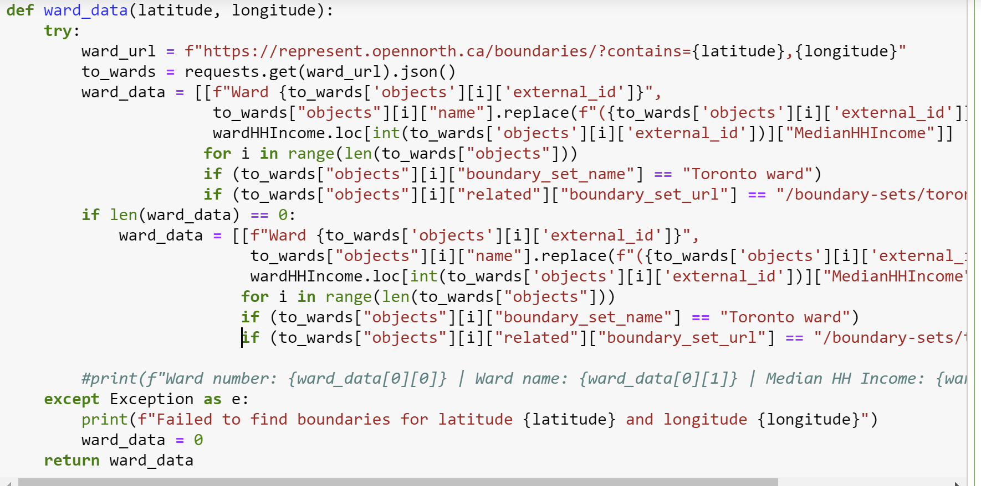

Slide 6
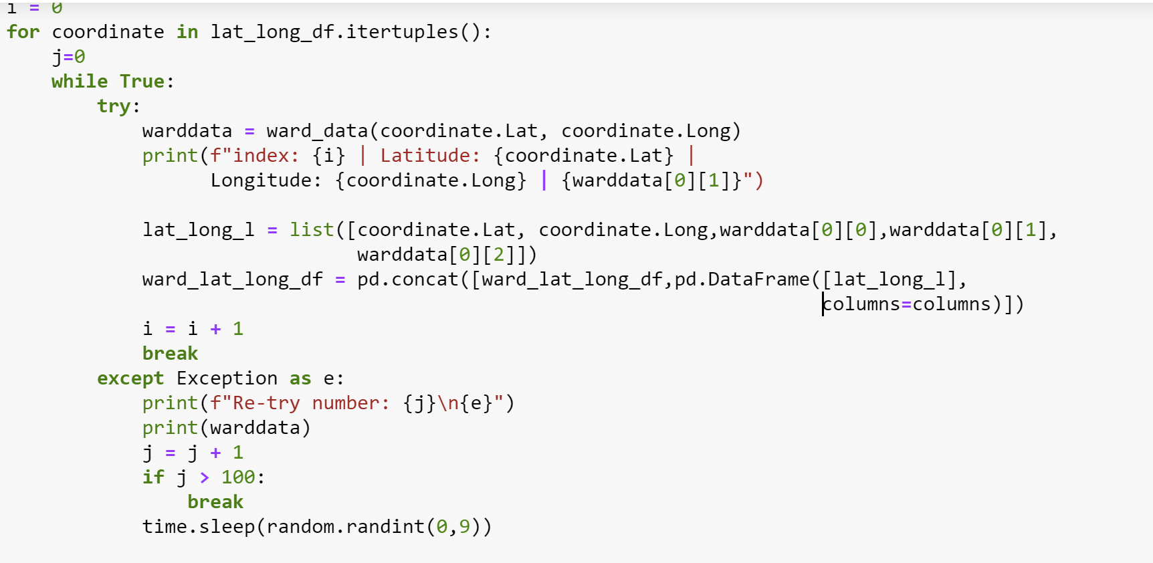

Slide 7
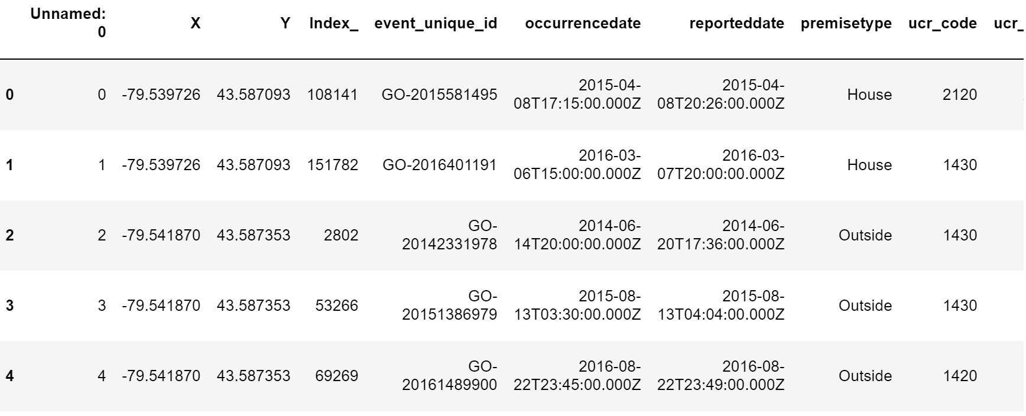
Offences Table

Slide 8
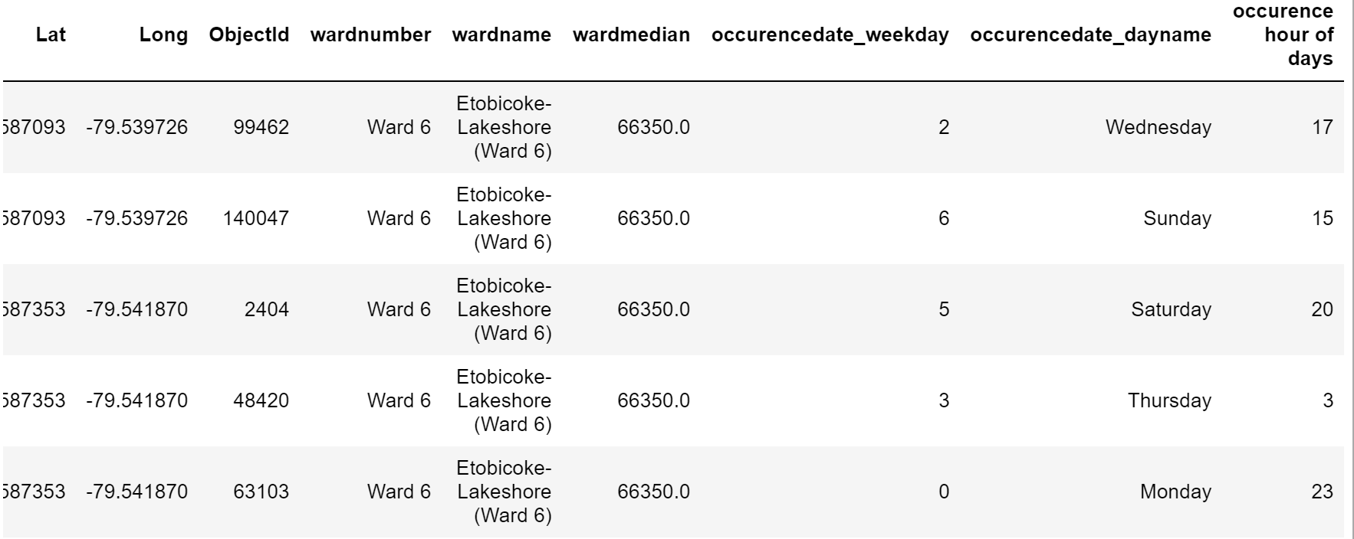
Offences Table

Slide 9
NULL Hypothesis
The household median income, based on wards, has no significance on crime occurrences
The day of week has no significance on crime occurrences
The time of day has no significance on crime occurrence
The premise type has no significance on crime occurrence

Slide 10
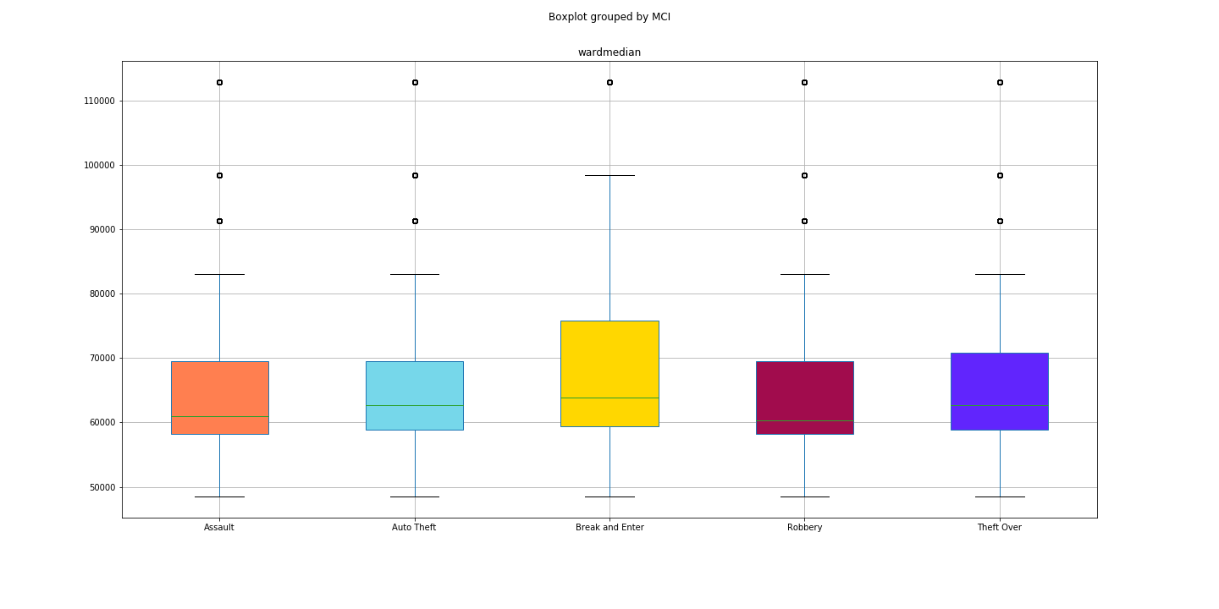
Data Analysis
Household median income

Slide 11
The lower end of the household median income shows I higher concentration of all MCI.
We performed the Anova test on the data with the following results:
F_onewayResult(statistic=58.37610293629495, pvalue=2.6781825793278318e-33)
P-value ≤ 0.05: we reject the null hypothesis and conclude that the household median income is statistically significant to the crime occurrences.

Slide 12
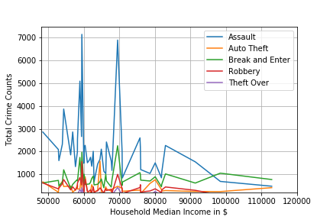
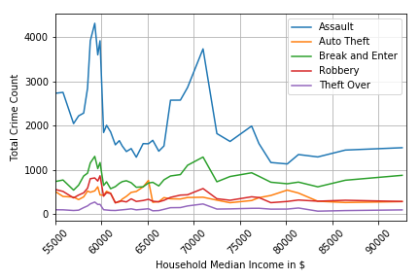
Data Analysis
Household median income

Slide 13
In order to produce a smoother version of this plot we used moving averages:
def expmovingaverage(values, window):
weights = np.exp(np.linspace(-1.,0.,window))
weights /= weights.sum()
a = np.convolve(values, weights)[:len(values)]
a[:window] = a[window]
return(a)
for i in range(len(MCI_df_Groupby_ward_pivot)):
mci = [k for k in MCI_df_Groupby_ward_pivot.columns],[MCI_df_Groupby_ward_pivot[y].iloc[i] for y in MCI_df_Groupby_ward_pivot.columns]
plt.plot(expmovingaverage(mci[0], 4),expmovingaverage(mci[1], 4))

Slide 14
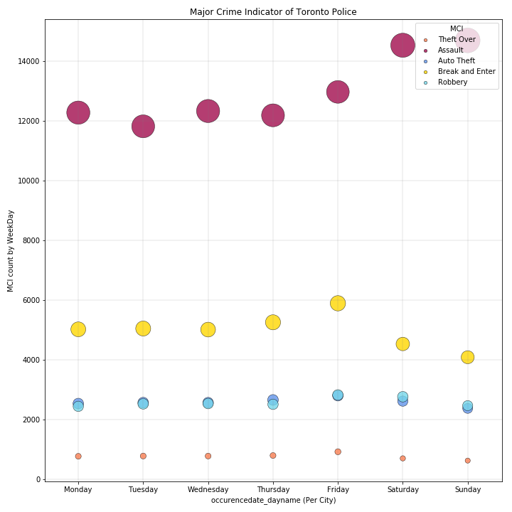
Data Analysis
Day of the week

Slide 15
The data shows that there is a relationship between day of week and crime occurrence.
We performed the Anova test to compare all 5 MCI across the seven days of the week
F_onewayResult(statistic=466.9972184056322, pvalue=1.5137362091572156e-26)
The p-value is lower the 0.05 hence we can reject the NULL hypothesis. The relationship between crime and day of week is statistically significant.

Slide 16
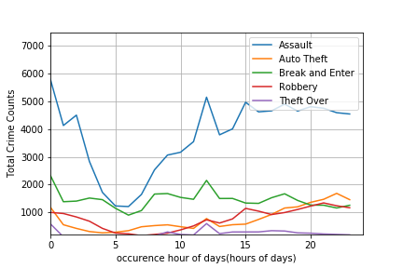
Data Analysis
Time of day

Slide 17
The data shows there is a relation between the time of day and the crime occurrences
We performed the Anova test on the set of MCI across the 5 premise types
F_onewayResult(statistic=9.843241490116789, pvalue=0.00014355566838504356)
The p-value is lower the 0.05 hence we can reject the NULL hypothesis. The relationship between crime and type of premise is statistically significant

Slide 18
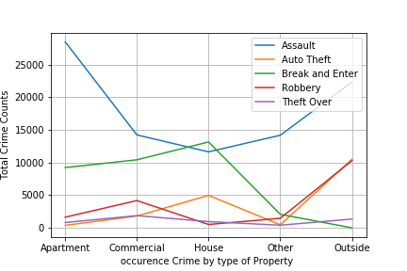
Data Analysis
Type of premise

Slide 19
The data shows there is a relation between the type of premise and the crime occurrences
We performed the Anova test on the set of MCI across the 24 hours of day
F_onewayResult(statistic=108.05844287998815, pvalue=5.150589670998093e-38)
The p-value is lower the 0.05 hence we can reject the NULL hypothesis. The relationship between crime and time of day is statistically significant

Slide 20
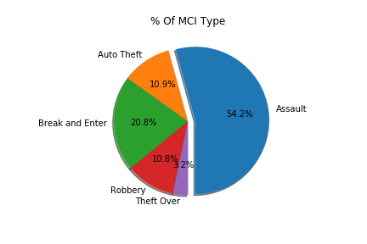
Data Analysis
Overall view and summary

Slide 21
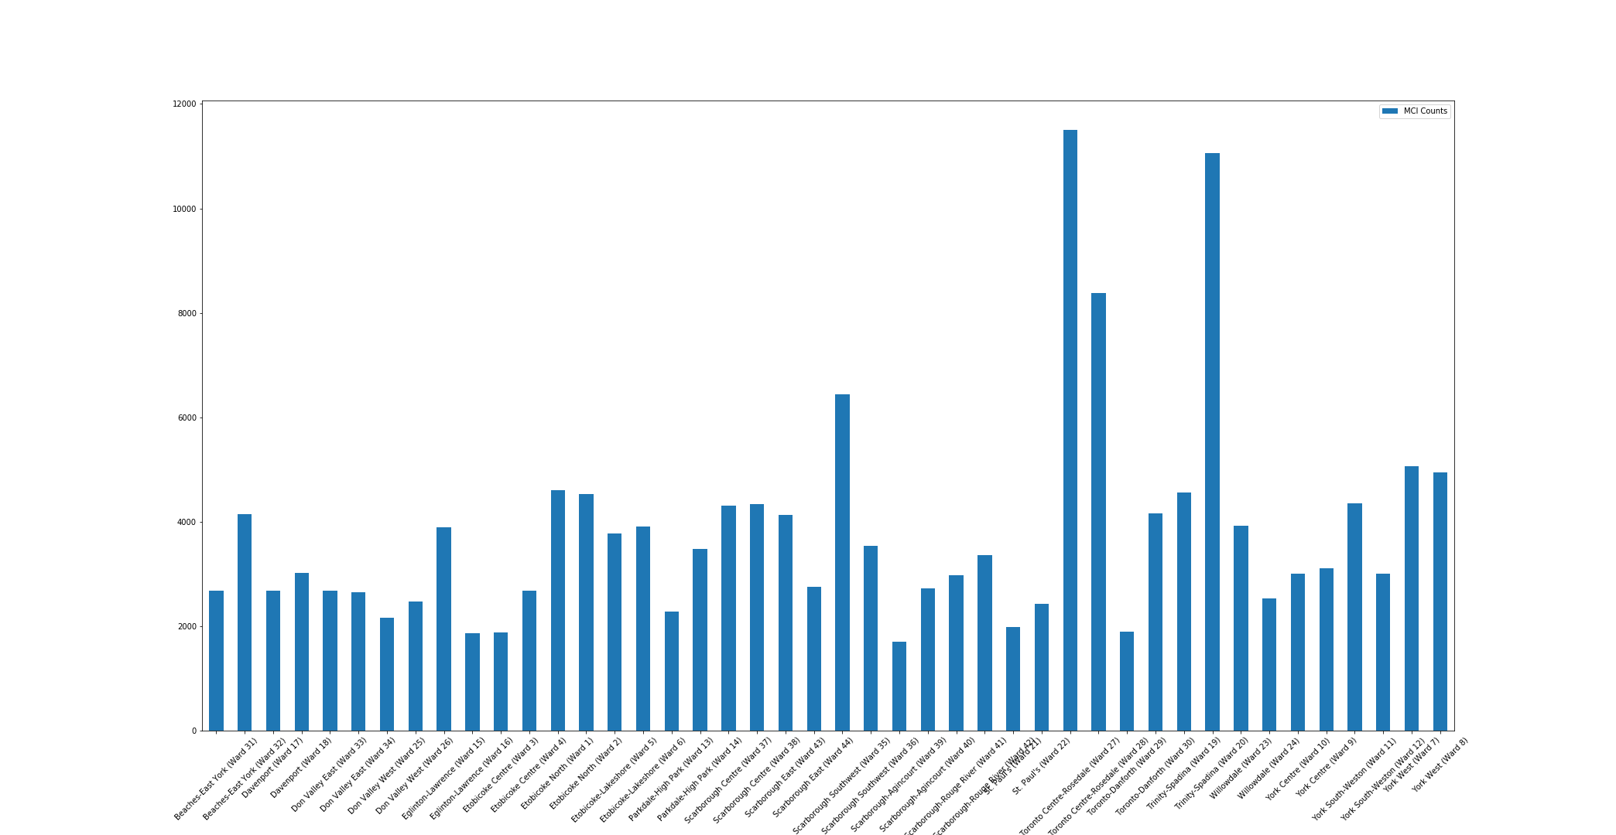

Slide 22
Questions
Open-floor Q&A with the audience

Slide 23

Thank you!

